Slide 1
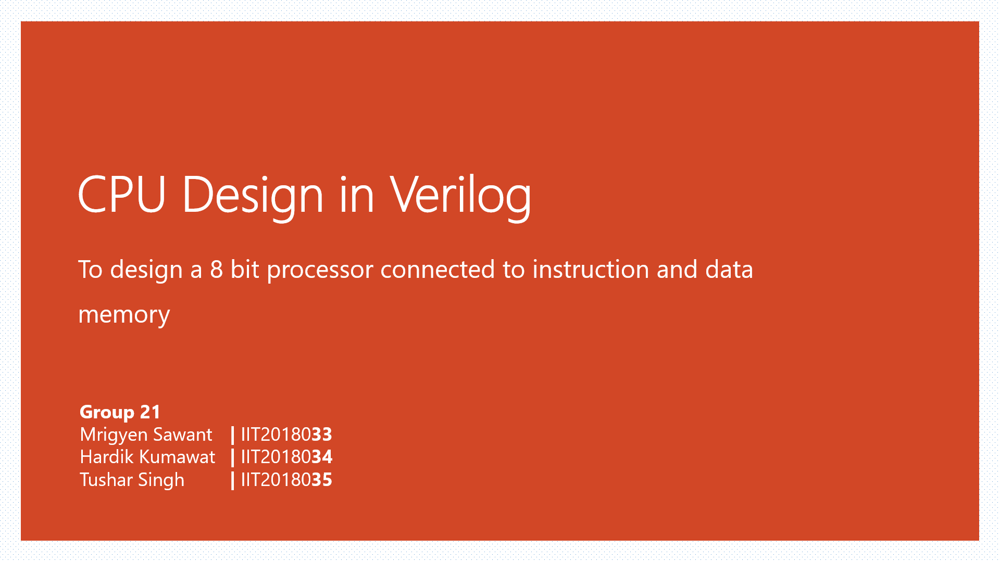

Slide 2
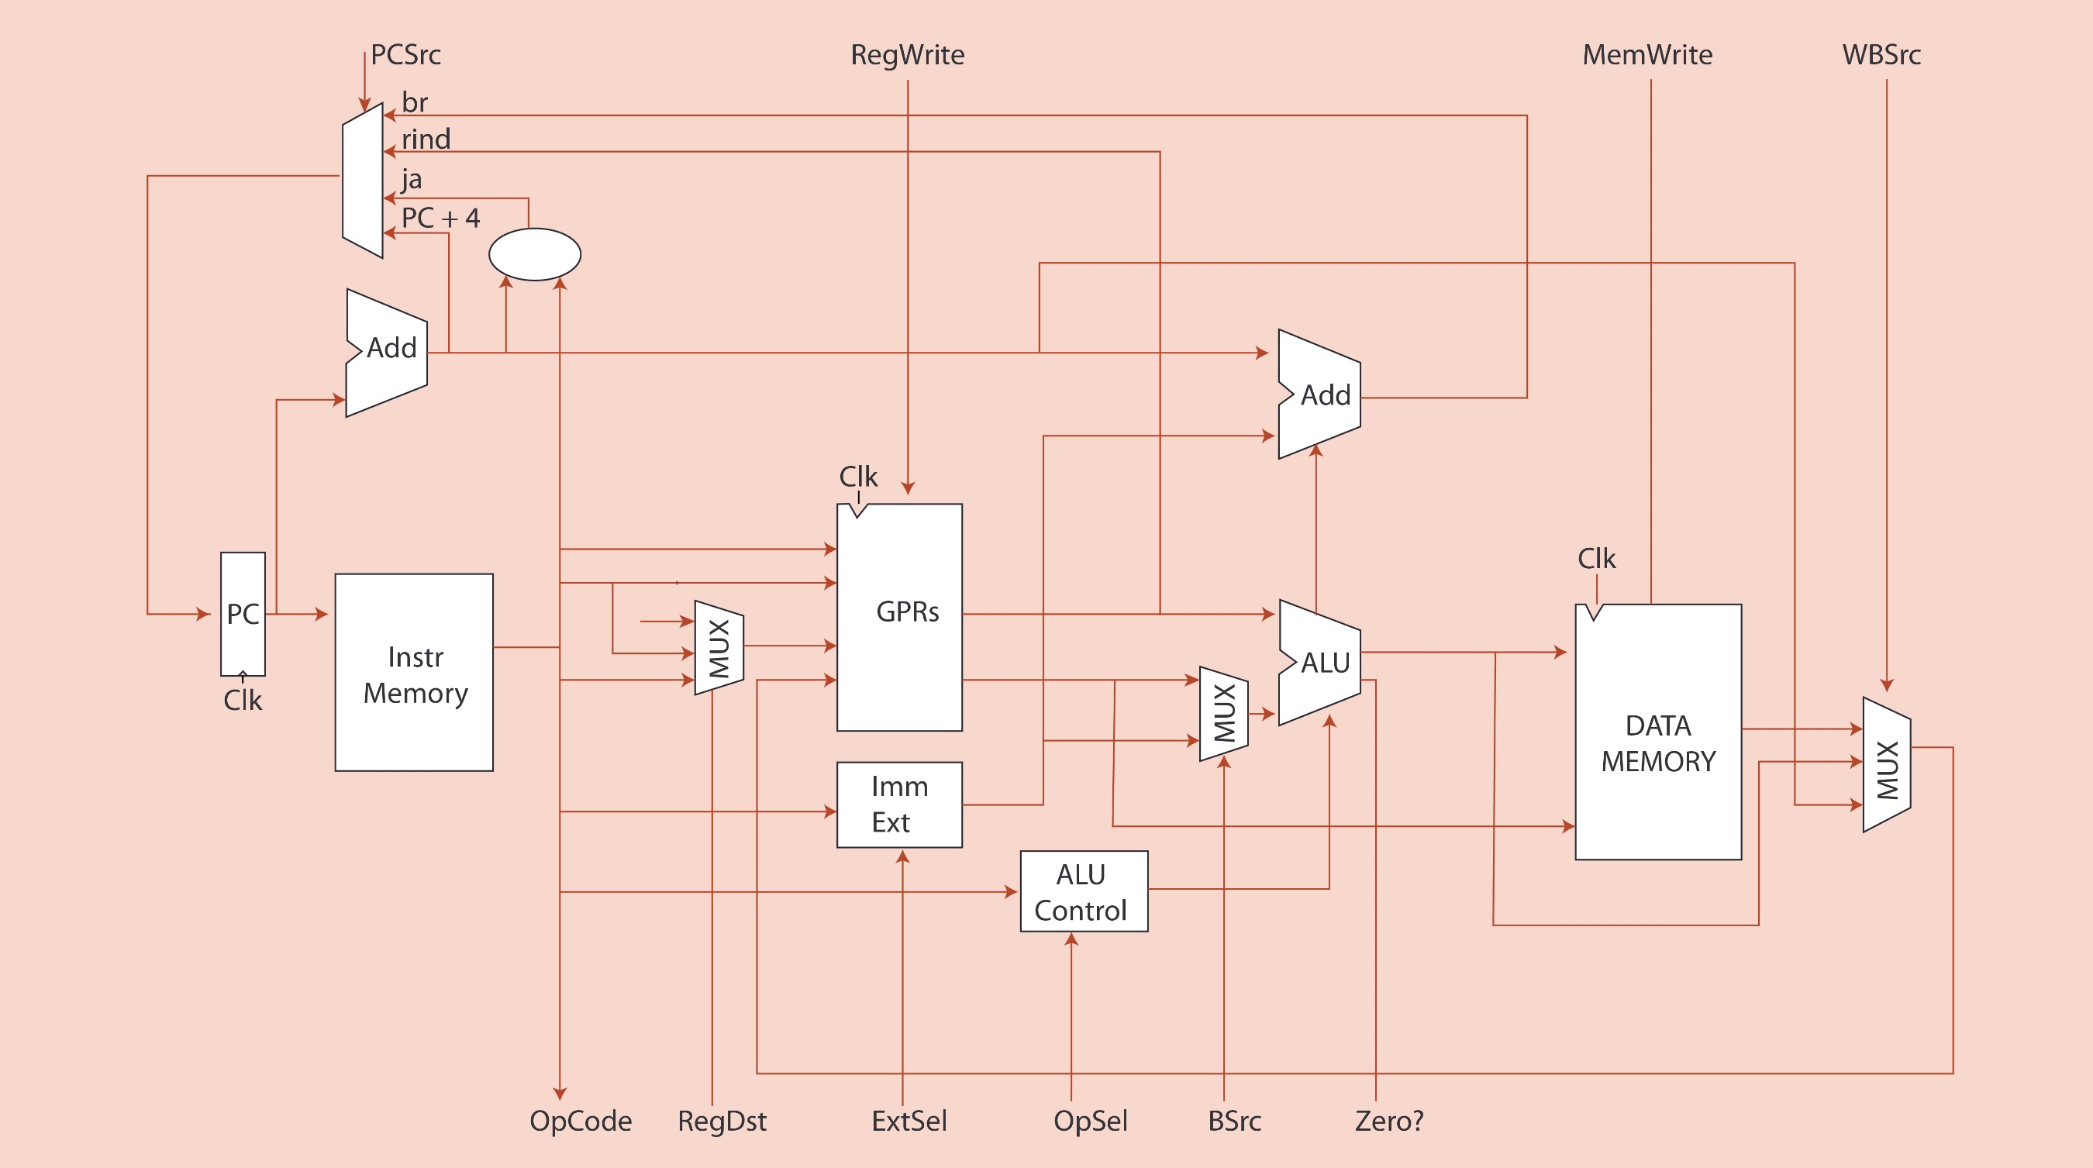
MUX
SL2
CONTROL UNIT

Slide 3
Instruction Format
The CPU uses 16-bit instructions that are stored in the IMEM. There are 3 types of instructions
Memory access : load
OP | RS1 | WS | offset
4 | 3 | 3 | 6
Memory access : store
OP | RS1 | WS | offset
4 | 3 | 3 | 6
Data Processing : bitwise AND, bitwise OR, add, sub, etc.
OP | RS1 | RS2 | WS | USELESS
4 | 3 | 3 | 3 | 3

Slide 4
Instruction Format
BRANCH
OP | RS1 | RS2 | OFFSET
4 | 3 | 3 | 6
Memory access : store
OP | OFFSET
4 | 12

Slide 5
Instructions
Opcode | Instruction
0000 | Load Word
0001 | Store Word
0002 | Add
0003 | Subtract
0004 | Invert (1s complement)
0005 | Logical Shift Left
0006 | Logical Shift Right
0007 | Bitwise AND
0008 | Bitwise OR
0009 | Set On Less Than
0011 | Branch on Equal
0012 | Branch on not Equal
0013 | Jump

Slide 6

Modules of CPU
`
Alu.v
Alu_Control.v
Combined.v
Control_Unit.v
Data_Memory.v
Datapath_Unit.v
Gprs.v
Instruction_Memory.v
Testbench.v

Slide 7
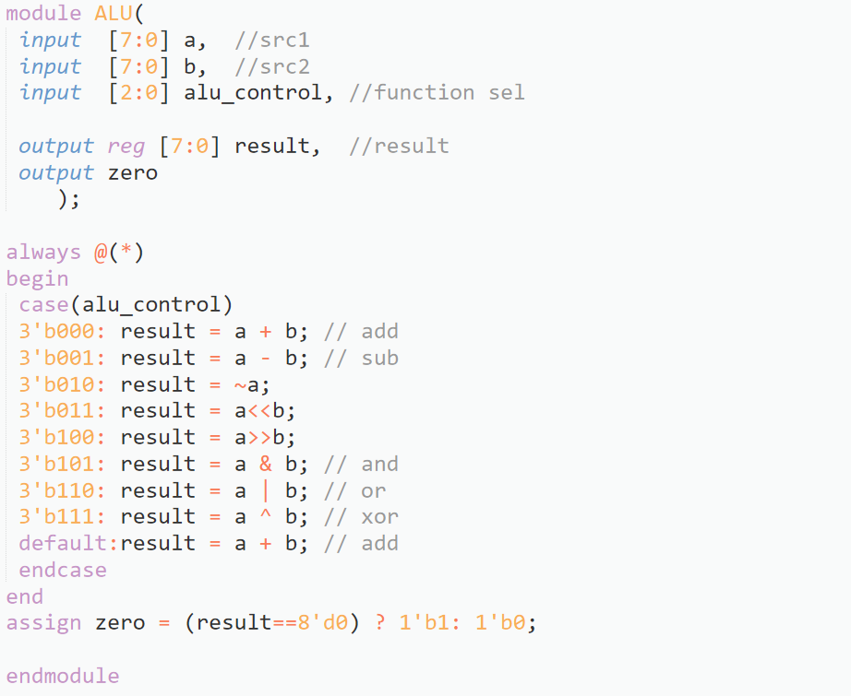
Arithmetic And Logic Unit (alu.v)
Takes input as two 8 bit binary numbers a and b, and alu_control, a 3 bit binary number that is output of alu_control.v
This module outputs a 8 bit binary number that is a result of the operation performed.
A variable called zero is also an output, that determines whether the result is useful.
This module computes the result of the required operation, and sends meaningful output.

Slide 8
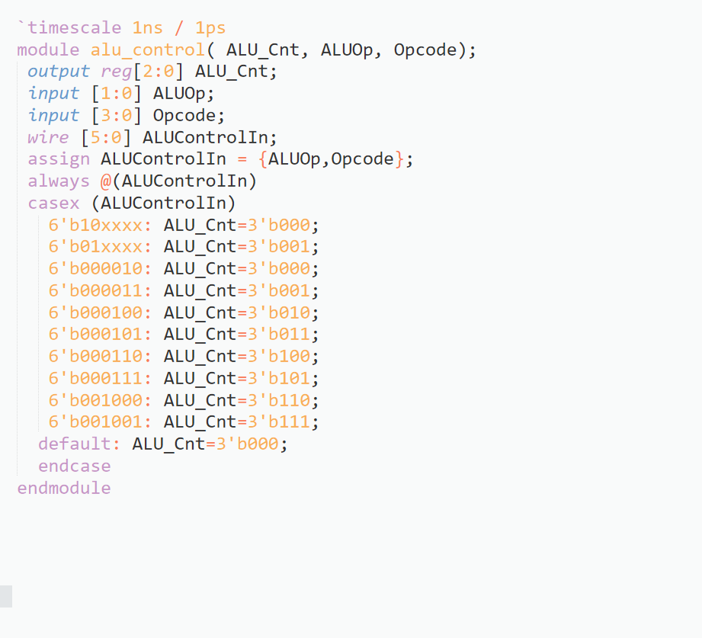
ALU Control (alu_control.v)
The inputs to this module are :
2 bit binary variable called ALUOp, which is piped into this module from the Datapath_Unit.v module, which in turn is piped into this module from the combined.v module.
4 bit binary variable called Opcode
This module outputs a 3 bit binary variable called ALU_Cnt
This module uses a switch-case to give an output of ALU_Cnt which is then piped into ALU.v

Slide 9
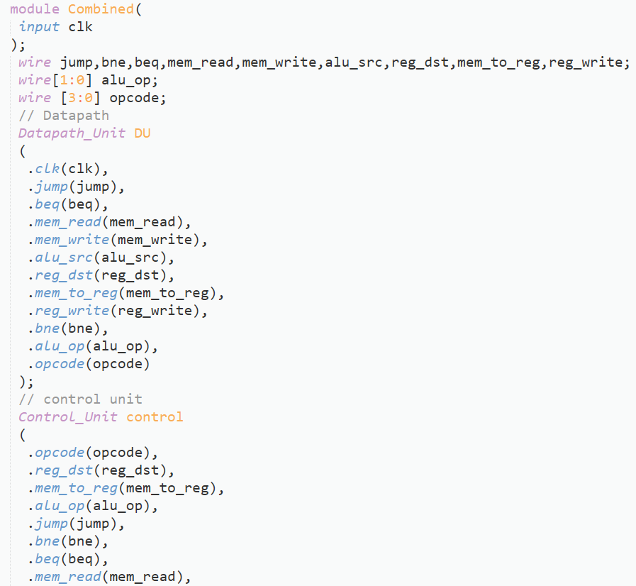
Combined.v
This module only has an input called clk, which is the clock variable.
The function of this module is to pipe data between datapath_unit and control_unit.

Slide 10
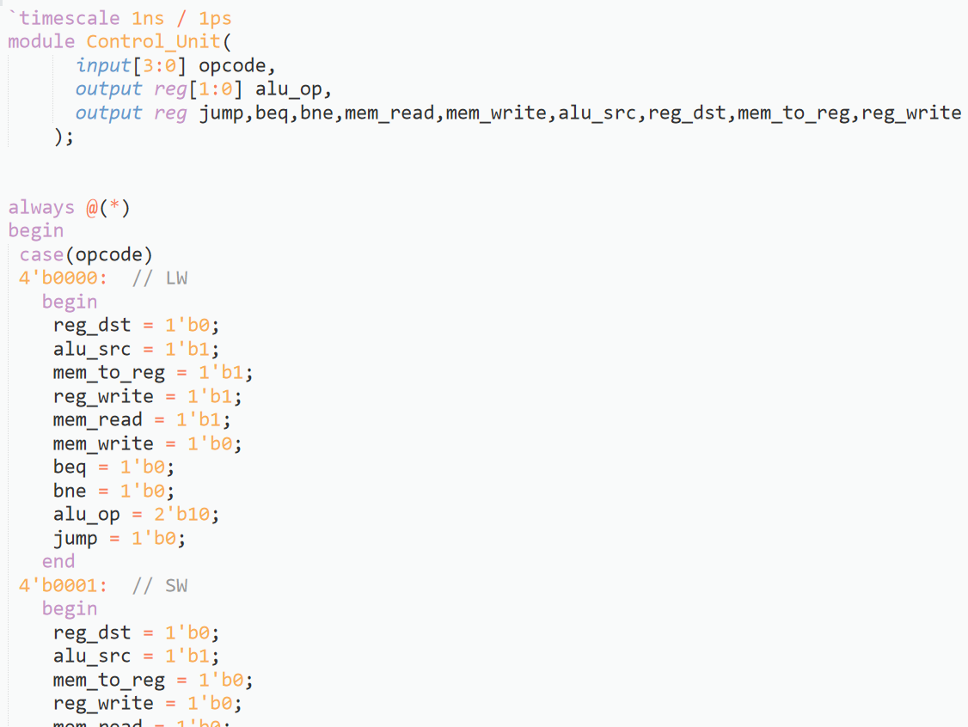
Control Unit (control_unit.v)
This module takes input as a 4 bit binary variable called OpCode, which contains the opcode.
This module sends control signals as output
There are multiple outputs :
alu_op – 2 bit binary variable which specifies the type of operation to be performed
jump – this variable specifies if a jump type operation occurs
beq – specifies if a beq operation is being performed

Slide 11
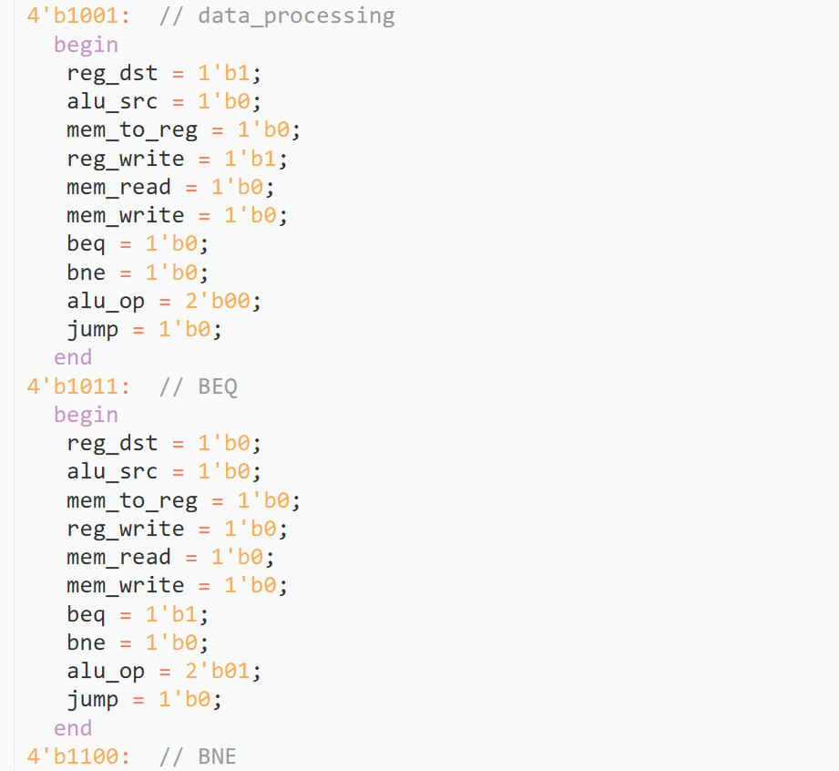
Control Unit (control_unit.v)
More outputs :
bne – specifies if a bne operation is being performed
mem_read – specifies if memory must be read
mem_write – specifies if there should be a write operation in the memory
alu_src – determines if an immediate or register data is provided to alu
reg_dst – specifies if write occurs in register
mem_to_reg - specifies if register input data is provided from alu or data memory

Slide 12
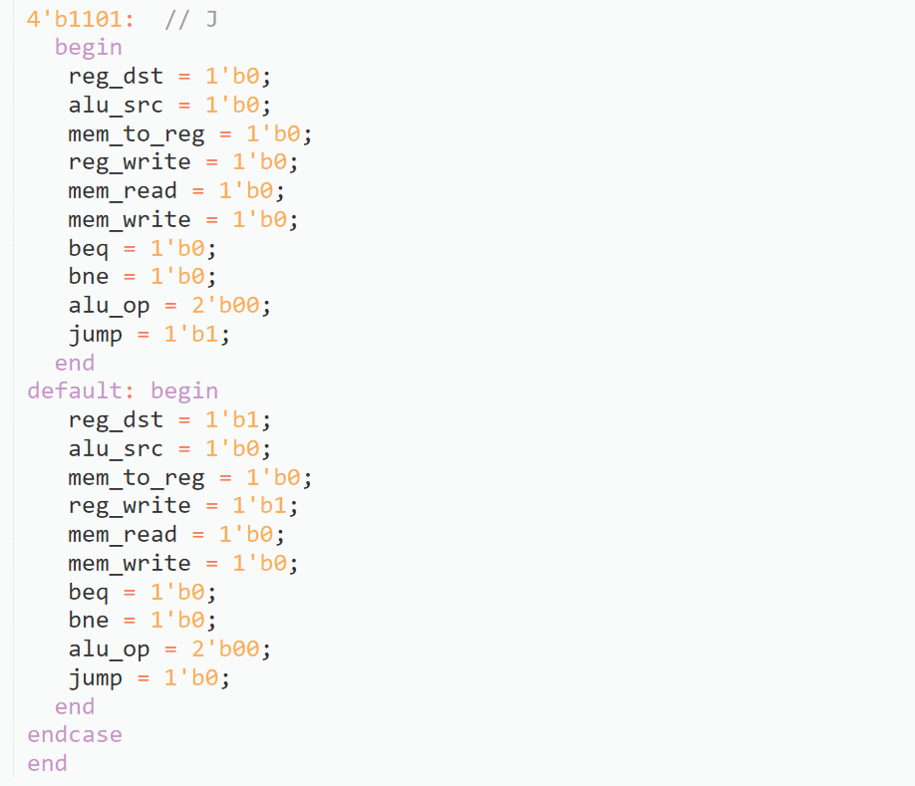
Control Unit (control_unit.v)
More outputs :
reg_write – specifies if the instruction updates value of any register
This module reads the opcode and then sends the relevant control signals as output
It uses a switch case

Slide 13
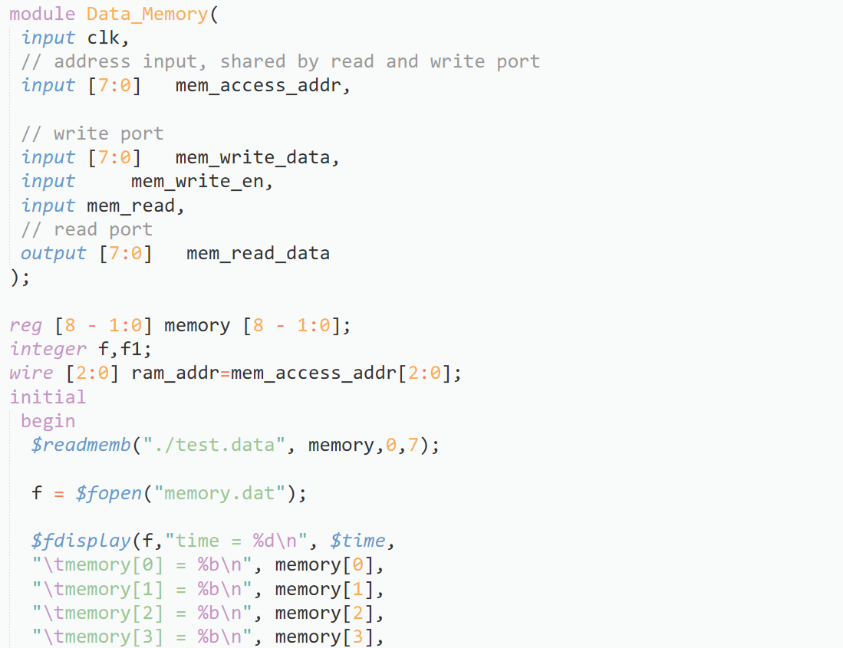
Data Memory (data_memory.v)
Inputs to this module are
clk – clock variable
mem_access_addr - 8 bit binary number, contains the address of the memory to be accessed
mem_write_data – 8 bit binary number, contains data to be written to memory
mem_write_en – which if true, tells the module to copy the mem_write_data into the memory.
mem_read – which if true, reads the specified memory address

Slide 14
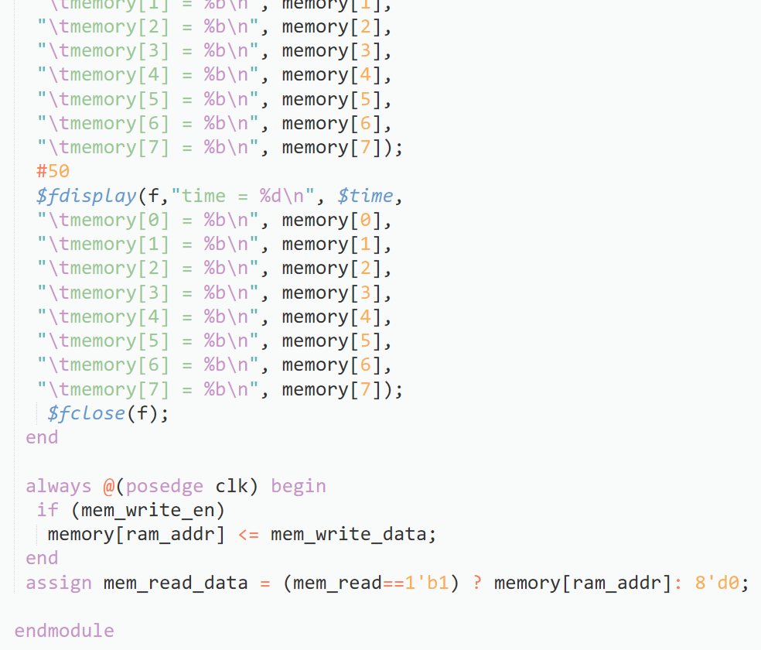
Data Memory (data_memory.v)
output – mem_read_data which is a 8 bit binary data that contains the data that we read from specified memory address if the memory is read.
The module also contains code that prints out initial and final states of memory.

Slide 15
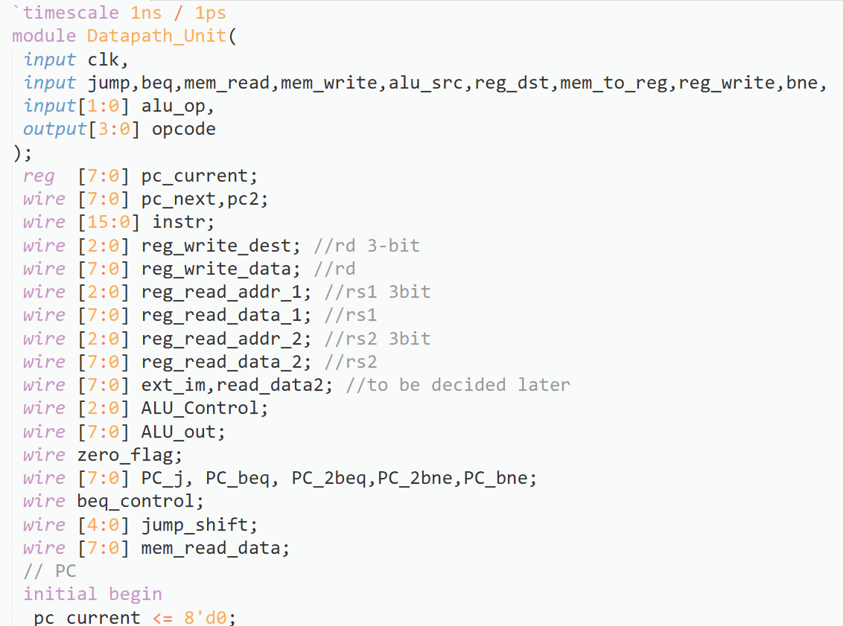
Data Path Unit (datapath_unit.v)
This module takes input as the clk variable, and control signals that are output from control unit module.
Output variable is a 4 bit binary number that is the opcode, which if extracted from the beginning of the instructon.
In this module, we initialize the program counter and we update it with each instruction’s execution, depending upon instruction and its execution ( for eg. for j, bne, beq the PC is updated to relevant value.)
This module extracts relevant information for GPRS module and pipes that data into it.
We also pipe relevant data into, and out of, the alu_control module and the ALU module and the Data_Memory module.

Slide 16
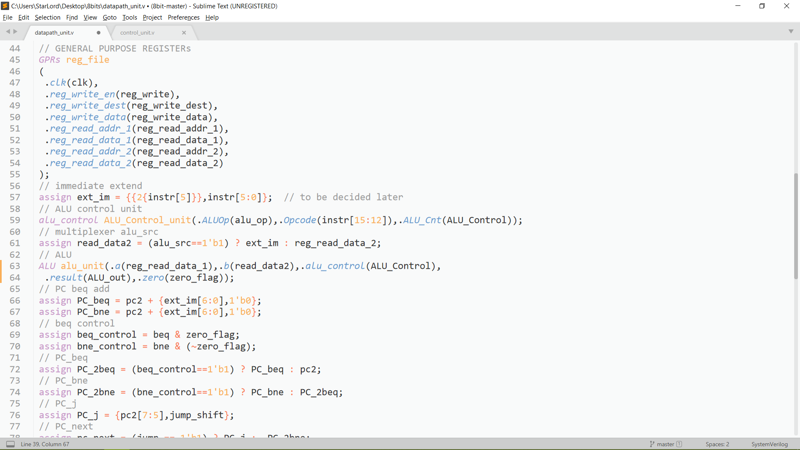
Data Path Unit (datapath_unit.v)
This module extracts relevant information for GPRS module and pipes that data into it.
We also pipe relevant data into, and out of, the alu_control module and the ALU module and the Data_Memory module.

Slide 17
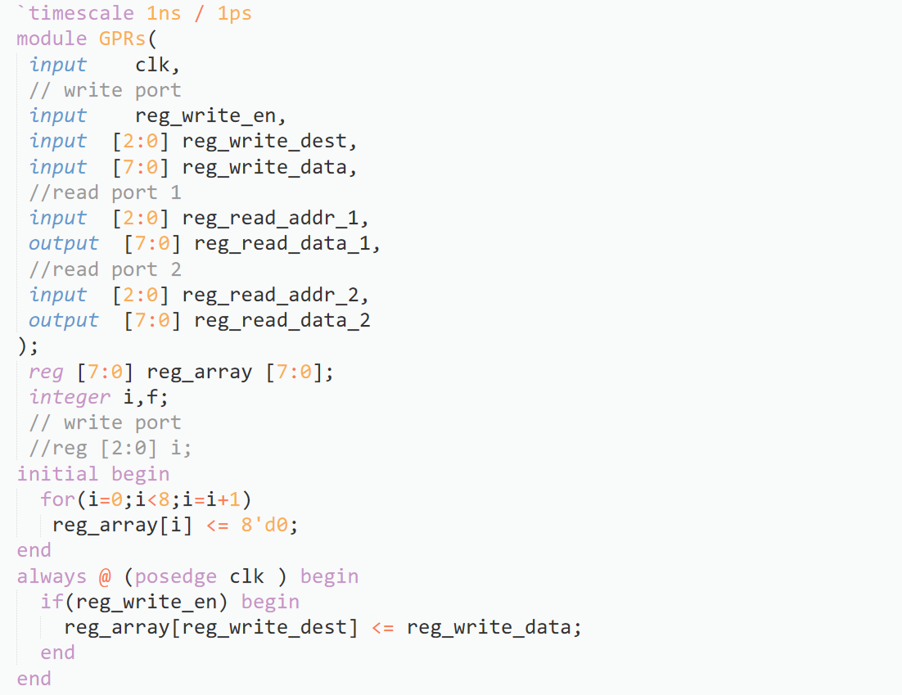
GPRS.v
The inputs to this module are
clk – clock variable
reg_write_en – enabler variable for writing data into register block
reg_write_dest – 3 bit binary number, which is the destination address for writing into register
reg_write_data – it is the 8 bit immediate data that is supposed to be written into the register block
reg_read_addr_1 – a 3 bit binary number which is address of register to be read

Slide 18
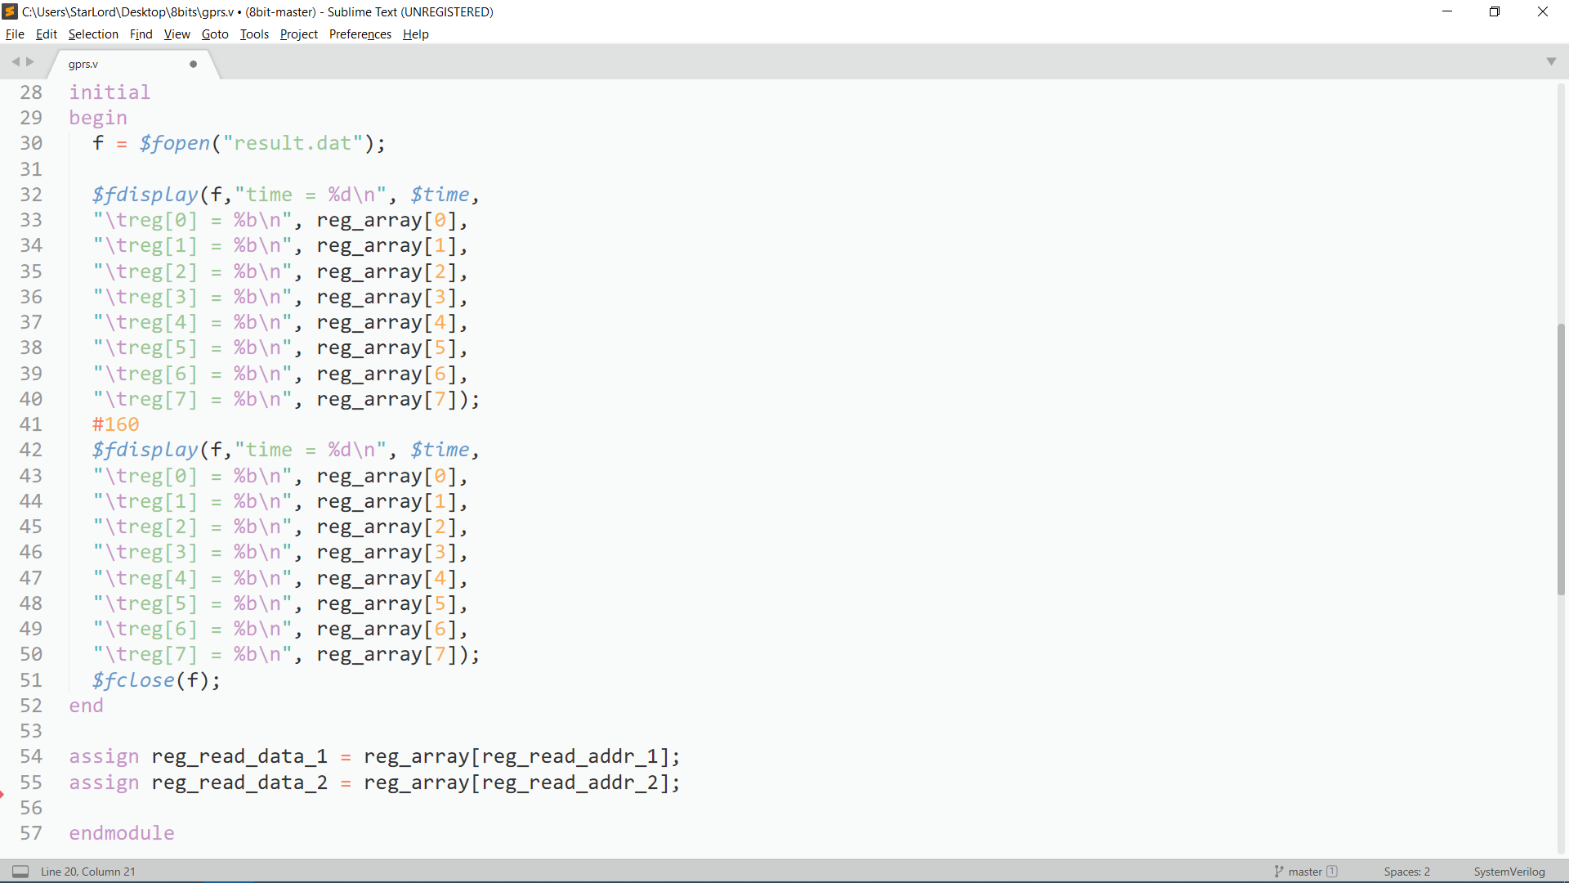
GPRS.v
More inputs :
reg_read_addr_2 - a 3 bit binary number which is address of register to be read
Outputs :
reg_read_data_1 – an 8 bit binary variable that contains the data from the reg_read_addr_1
reg_read_data_2 - an 8 bit binary variable that contains the data from the reg_read_addr_2

Slide 19
GPRS.v
This module initializes the register array and updates with every positive edge of the clock
Also outputs a file, result.dat, that contains initial and final states of registers.

Slide 20
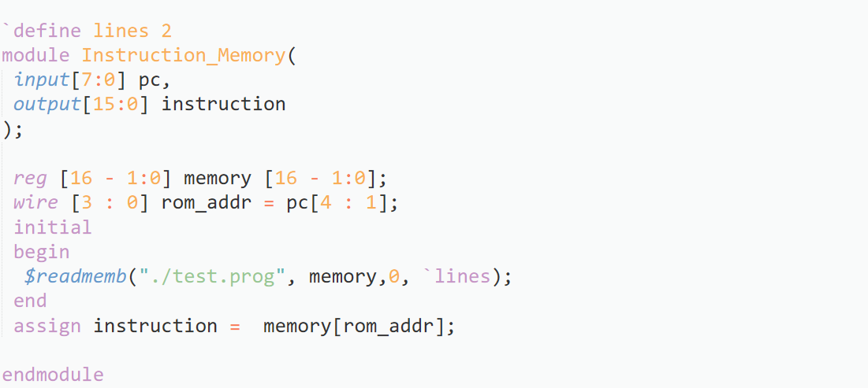
Instruction Memory (instruction_memory.v)
Contains one 8 bit input variable called pc, which is the program counter
It contains one 16 bit output name instruction that contains the current instruction that is being executed.
Reads the instruction memory from test.prog file.

Slide 21
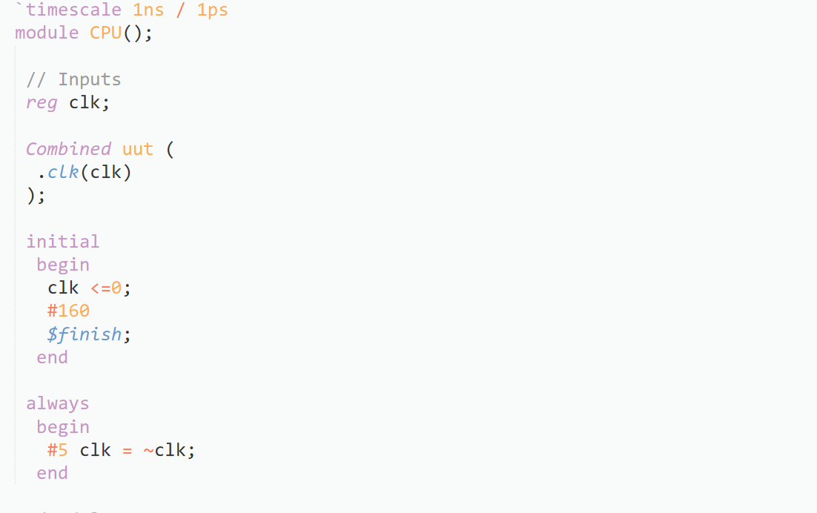
Testbench (testbench.v)
This module controls the clk variable
Pipes the value of the clk into combined.v module

Slide 22
Testing
To test the processor, we need a set of instructions.
We input these instructions into test.prog file.
Similarly, we need an initial state for the memory block and we input this into test.data file.
In instruction_memory.v module, we need to ensure that the lines macro definition equals the number of lines we want to read from the test.prog starting from the first line.

Slide 23
Testing
$ iverilog *.v –o out
This command compiles the modules to generate executable
$ ./out
This command executes our test program using the 8 bit processor
OUTPUT : the above commands generate two output files, memory.dat and result.dat
Result.dat contains the initial and final states of register block.
Memory.dat contains the initial and final states of memory block.

Slide 24
Special thanks to Dr. Bibhas Ghoshal and the TAs
Thank You

